Slide 1
Proposal Development Overview by Proposal Development Committee
In
Ad Hoc CCM meeting
23 August 2017

Slide 2
Objective of the presentation
Role of PDC
Processes adopted
Timelines followed
Discussions and decisions
Key pointers for programme teams

Slide 3
Role of PDC
Harmonization
Gap analysis: for both programmatic and financial, which account for the full extent of existing resources.
Determining priorities: after actively and extensively seeking inputs from all stakeholders.
Facilitating Principal Recipient selection
Coordinating consultants/ technical support
Proposal review by all stakeholders
Liasoning: maximize integration, coordination and alignment, and to avoid duplication.

Slide 4
Process and Timeline
Five formal PDC meetings were organized to take the proposal development process forward.
Suggested the timeline for further actions.
PDC team members have participated in skype calls with FPM.
PDC members have provided offline support in reviewing and providing feedback to projects

Slide 5
1st PDC meeting (18 December 2016)
Outcomes:
Program split was agreed, however, programs proposed discussion among them and get back to PDC and propose for CCM’s endorsement.
Program proposed not to submit on the first window, as they needed to finalise the NSP.
Fund portfolio Manager- FPM (via Skype) informed that she would get back to the program on the next window of submission.

Slide 6
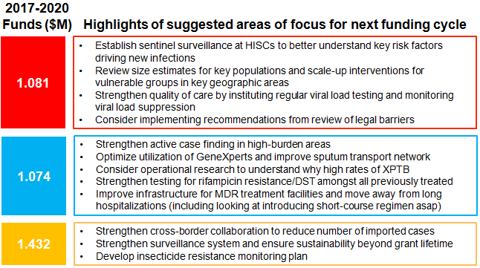
2nd PDC meeting (17 March 2017) organized in the presence of GF team
Outcome: Timeline reviewed to apply on 28 August 2017

Slide 7
Outcome of second meeting
Mr. Gonzalo Penacoba, STC Specialist, GF; presented Highlights of the STC policy:
Procurement of drugs, legal environment issues and increasing number of MDR-TB
Suggested to focus on short-term courses of treatment and focus more on migrant worker during this transaction period. Highlights of the STC Policy:
Sustainability: Ability of health program or country to both maintain and scale up service coverage to a level, in line with epidemiological context, that will provide for continuing control of a public health problem and support efforts for elimination of the three diseases, even after the removal of external funding by the Global Fund and other major external donors.
The transition as the mechanism by which a country, or a country-component, moves towards fully funding and implementing its health programs independent of Global Fund support while continuing to sustain the gains and scaling up as appropriate.
Co-financing as pooled domestic public resources, including government revenues, government borrowings, social health insurance, etc and domestic private contributions that finance the health sector financed by the Global Fund.
FPM, GF added that CSO and other organization needs to be institutionalized and services for the key populations (vulnerable and marginalized groups) are to be absorbed by governments during this transaction period.

Slide 8
3rd PDC meeting (9th May 2017)
Outcome:
Timeline reviewed and finalized
Progress updated and way forward agreed.
Background:
Following the Lyonpo’s meeting at the Global Fund to include BHTF as part of sustainability post GF support which would automatically apply that Bhutan submit the Tailored review approach in place of project continuity plan.
Further multiple Skype conference with Lindsey on the approach and STC discussed.

Slide 9
Facilitation of PR Selection process
As per time plan 35th CCM meeting on 7 June endorsed the program split and TR proposal endorsed with inclusion of BHTF as measure for STC.
PR selection discussed and recommended the final PR for the next cycle of GF to CCM by 30 June as an outcome of the PR selection process.
Criteria decided, advertised, no applications were received by last date. Report shared to the CCM via email.

Slide 10
Meeting between Programs, WHO and BHTF (22 June)
To finalize the revised time plan for Tailored review and share with the FPM for feedback/approval

Slide 11
4th PDC meeting (20 July 2017)
Outcome:
WHO and PDC comments on proposals were reviewed and summary shared with the programs to incorporate and requested share the next version by 28 July.
Requested to share final costed NSP and annexes shared with the 1st draft of individual programme proposals.
FPM (via Skype) joined to share her reviews on the zero draft of the proposal in addition to seeking clarity on STC.
BHTF was requested to share write-up, charter, and BHTF’s special board meeting minutes by 26 July.
Agreed for Ad hoc CCM meeting to endorse proposal– 17 August.

Slide 12
5th PDC meeting (31 July 2017)
Outcome:
Revise draft of TB proposal was reviewed during the meeting. The TB program requested to submit revised version (2nd draft) by 4 August 2017, incorporating Sustainability, Transition, and Co-financing component and attaching all annexures for further review.
Sustainability, Transition, and Co-financing write-up would include :
Above allocation: funding approach should consider the best benefit for the three programs in long-term, which can be including BHTF to apply for above allocation incentive funding of 15% or beyond, upon meeting the co-financing requirement along with the three proposal.
It is mandatory to meet the co-financing requirement commitment as it was done in the previous years/grants.
Within allocation: funding approach could include procurement of drugs/ or commodities through BHTF. This would need to be explicitly mentioned in the proposal and appropriately reflected in the budget along with commodity/drug specific sustainability built in and appropriate co-financing reflected.
Other programs although could not attend the meeting sent their 2nd draft in the following week.

Slide 13
Major feedbacks on proposals from GF
These are all related to sustainability, transition and co-financing
HIV AIDS: cost of drugs (% contribution)
Malaria: cost of LLIN bed nets (targets/universal/cost sharing)
TB: strategy for elimination and management of MDR
BHTF: sustainability strategy/ procurement policy

Slide 14
Key pointers for programme officers
NSP should be a dynamic and well-consulted document- it can be improved through a wider consultation including the key technical working groups, CSOs and key and vulnerable populations.
Sustainability, Transition, and Co-financing: STC for NSP and BHTF write-up (above the allocation is provided and within the allocation should include drug/commodities procurement)
Financial gap analysis and plan to address it.

Slide 15
THANKS

