Slide 1
Tailored Review Material Change-GF-Proposal
Lekey Khandu
Program Officer
National HIV, AIDS & STIs Control Program

Slide 2
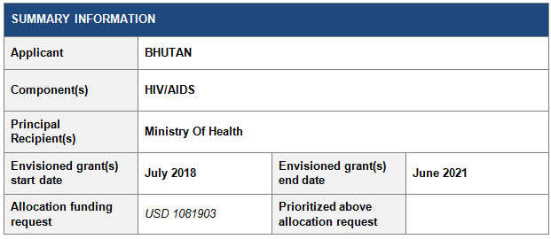

Slide 3
Goal: To achieve 90-100-90 global targets for HIV response by 2020, and continue through the planning period, towards ending the HIV epidemic by 2030
Objectives
To achieve 90% test and 100% treat targets by 2020.
To eliminate new infection among children by 2020.
To retain PLHIV on treatment, resulting in 90% viral suppression.

Slide 4
Goal: To achieve 90-100-90 global targets for HIV response by 2020, and continue through the planning period, towards ending the HIV epidemic by 2030
Objectives
To achieve 90% test and 100% treat targets by 2020.
To eliminate new infection among children by 2020 with 95% of ANC attendees availing HIV test at least once during their pregnancy term.
To retain PLHIV on treatment, resulting in 90% viral suppression, so that HIV infection is reduced.

Slide 5
Process of Proposal Development
Guided by NSP-III, GARPR-2016, IBBS report, UNAIDS and Programmatic experience and review.
Consultative meeting with TWG members and key partners.
Submission of draft proposal to PDC (zero draft and 1st Draft)

Slide 6
Why Material Change for this time?
To gear towards ending AIDS epidemic by 2030 in line with goals set under SDG.
To eliminate pediatric HIV by 2020.
To reduce new HIV infections by maintaining undetectable VL (< 1000 copies)
To bridge the current detection gap.

Slide 7
Epidemiological contextual updates
Notes:
Today, Bhutan is one of the few countries in South Asia that continues to experience a low adult (15-49 years) HIV prevalence, which is estimated to be under 0.1 per cent (<0.1-0.4%). As of July 2017 the total cumulative number of HIV cases stands at 548 (284 male and 264 Female) (National Program Report, 2017). Over the past ten years there has been a steady increase in case detections due to scale up of outreach for testing services through the donor support in particular the Global Fund.

Slide 8
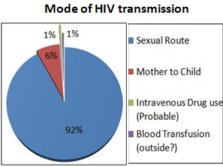
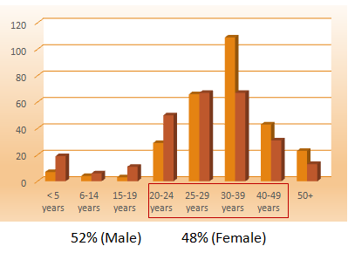
Epidemiological contextual updates
Notes:
How is HIV infected in Bhutan? Majority, about 92% of the reported cases have acquired the HIV infection through the heterosexual followed by MTCT (6%) and rest through blood transfusion and IDUs. The several behavioral studies among the Bhutanese population also showed high multiples sexual practices and low condom use including the emergence of transactional sex in the booming entertainment centers in urban areas. Therefore, this proposal will gear towards enhancing the HIV prevention services including the development of targeted BCC materials, outreach activities with comprehensive package of services including the mobile HTC services.
In terms of case finding, majority (155) of the reported cases are detected through contact tracing and VCT followed by ANC and onsite screenings. Therefore, this proposal will try to strengthen the VCT coverage and contact tracing mechanisms through competency building of HISC and outreach workers in counseling and development of guidelines and SoPS . In addition to the routine medical screening for HIV (donated blood and blood products) now under this proposal all patients undergoing surgical procedure will also be screened for HIV once the protocol is put in place.

Slide 9
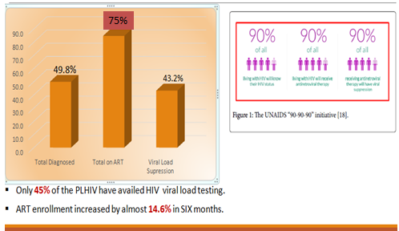
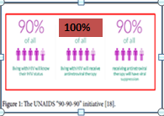
Care, Support and Treatment
Notes:
Of the total 548, there are 416 PLHIV of which 314 (75%) are currently on ART. One major achievement from the past investment has been in enrolling PLHIV on the treatment, care and support program in collaboration with positive networks and implementing partners. Access to testing services has also improve significantly. Under this proposal the program will introduce the viral load testing within the country to effectively monitor the treatment adherence to overcome the drug resistance.

Slide 10
International, Regional and National Policies and Commitments;
Revised NSP-III (2017-2023)
Revised National HIV, AIDS & STIs Treatment guidelines.
Sustainable Development Goals (SDG) of 2015.
Political Declaration on Fast-Tracking the AIDS response of 2016.
Global Fund Strategy 2017-2022.
WHO Health Sector Strategy on HIV/AIDS (2016-2021)
Notes:
Global Fund Strategy 2017-2022 for scaling up universal access to prevention and treatment and the WHO’s new treatment guidelines.

Slide 11
Prioritized Module
Prevention-HIV Testing Services
Scale up of testing package (HIV, Syphilis and Hepatitis) screening for all pregnant mothers.
EID guidelines will be developed and implemented for all children born to positive mothers.
Targeted community assisted testing for key population through outreach and in reach.
Mobile testing and health camp for vulnerable population .
Roll out of PITC in STI and TB clinics.
Strengthening of VCT coverage and contact tracing mechanisms.

Slide 12
Prioritized module
Care, Support and Treatment
Treating all PLHIV
Introduction of viral load testing
Strengthening the CD4 services
Capacity building of health workers on HIV management and drug adherence.
PMTCT
Comprehensive HIV services (HIV, Syphilis and Hepatitis).

Slide 13
Changes related to key and vulnerable populations and human rights and gender
The targeted population under NFM will continue;
High risk women
Mobile and migrants population
Adolescents & Youths
General Population
MSM/TG and IDUs
Human rights & gender: Development of action plan from the
recommendation of the recent legal review assessment report
2016 for key and vulnerable population.

Slide 14
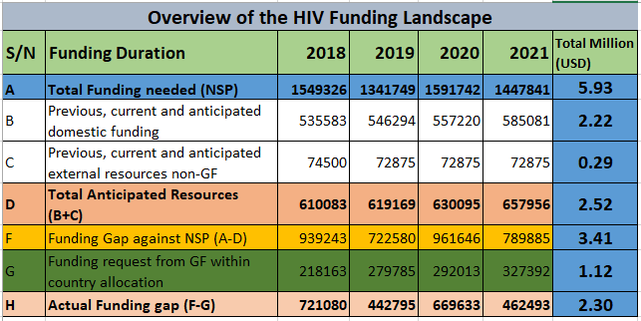

Slide 15
Sustainability
Commitment from RGoB for co-financing to BHTF
Mainstreaming the services into the government funded programs.
Majority of the interventions are well integrated into existing health and community system. E.g. PMTCT, PITC & HTC, CST.
ART drugs already listed in Govt. EDL list.
MoH advocating for the 5 of GDP share for health from 3 to 5%.
Transition and co-financing
RGoB contribution (Staff salary, overheads, allowances etc.)
50% of the cost for condom to be met from RGoB
The cost for the 2nd and 3rd line to met from RGoB.
For the PMTC services the government is providing the formula feeding to +ve infants.
Program and BHTF to explore innovative funding strategy to mobilize the fund to accommodate the 2nd and 3rd line ARV drugs on EDL post GF.
Notes:
The government has already started pumping in the matching fund to the existing Global Fund support of 15% above allocation under this funding request.
VCT/PITC services are well integrated in the MCH services in all BHUs and Hospitals. ARV drugs are listed in government EDL list indicating the RGoB support after the expiration of the global fund support. The other initiative is that MoH is strongly advocating for increase of 5% share of total GDP to health from current 3%. All these initiatives are geared towards ensuring the universal health coverage.

Slide 16
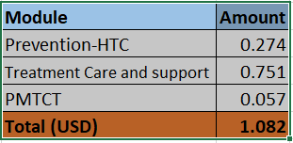
Cost category module wise

Slide 17
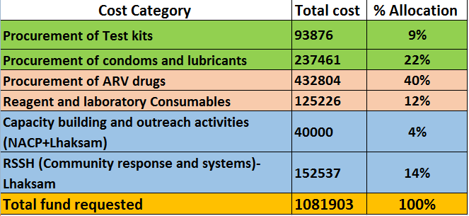
Cost category-Allocated GF fund

Slide 18
THANK YOU

