Slide 1
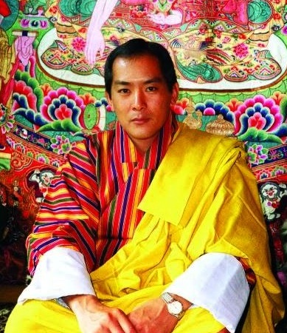
Bhutan Health Trust Fund
Sustainibility, Transition & Co-financing

Slide 2
Financing of Medicines
Four sources for financing of medicines
RGoB finances the named patient drugs (Nu. 20 million)
BHTF finances the essential drugs (429 allopathic drugs and 114 indigenous drugs)
Some specific drugs financed by donors through the specific programmes such as GFATM (Nu. 16 million)
Some drugs are donated such as cancer drugs by Max Foundation (Nu. 5.7 million)

Slide 3
BHTF Financing details
Year | MoH | JDWNRH | Total
2014-15 | 106,650,000 | 65,000,000 | 171,751,000
2015-16 | 110,000,000 | 74,000,000 | 184,000,000
2016-17 | 137,721,000 | 75,000,000 | 212,721,000
Total |  |  | 568,472,000

Slide 4
Financing Mechanism
BHTF acts like any other donor Agency.
Annual workplan and budget is submitted to Ministry of Finance and BoQ of drugs and budget is submitted to BHTF through the Ministry of Health in line with the approved five year plan.
BHTF reviews the plan in terms of whether BHTF can finance it from its revenue streams.
If it is financially sustainable for BHTF, it then releases whatever amount is approved by RGoB to MoF.
Annual reporting on expenditure and outcome to BHTF by implementing agencies

Slide 5
BHTF Organogram
Director
Asset Management
Administration & Finance
Administration
Board
Technical
Finance
Technical Committee
Asset Management Committee

Slide 6
Fund Status
Currently Nu. 1.6 billion against the fund target of Nu. 3 billion by 2018.
Target achieved on paper
Nu. 500 million from RGoB
USD 10 million from ADB (Nu. 650 million)
Nu. 150 million from Invesrment returns
Nu. 200 million from Bangladesh
Nu. 200 million from South Korea
Total Commitments = Nu. 1700 million

Slide 7
Sources of income
Endowments from Royal Government
Return on investments (Nu. 150 million)
Health Contribution from all salaried employees of Civil Service, Corporations and Private Sector (Nu. 200 million).
Voluntary contributions
Transition funding

Slide 8
Transition Funding
Year | GFATM | RGoB | Accrued Capital | Interest (+) | Cumulative
1 | 1,500,000 | 1,500,000 | 3,000,000 | 315,000 | 3,315,000
2 |  |  |  | 315,000 | 3,630,000
3 |  |  |  | 315,000 | 3,945,000
 |  |  | 3,945,000 | 414,225

Slide 9
Tashi Delek

