Slide 1
“Sustainability of Global Fund-supported programmes with a focus on(HR) capacity building in the Member States”
Palitha Abeykoon

Slide 2
GF/SIIC10/paper 08:
“The Development Continuum Working Group identified that as countries transition between income classifications they become eligible for far less in Global Fund support or lose eligibility altogether; with continued economic growth, a number of Global Fund countries may not be eligible for Global Fund financing in the near future. There is a risk that these countries will not be able to sustain the gains achieved through the Global Fund supported interventions. ….”

Slide 3
Transition and Sustainability
Transition: the process of moving away from direct donor support by developing mechanisms to manage health programs or interventions in a sustainable manner
Sustainability is the capacity of a country to independently manage their disease specific Programs in the long term without interruption or compromising quality
Source:
TRANSITION AND SUSTAINABILITY OF GLOBAL FUND-SUPPORTED PROGRAMS
SYNTHESIS REPORT OF SELECTED COUNTRY CAS STUDIES AND REVIEWS

Slide 4
Six building blocks of a health system
Good health services
A well-performing health workforce---- national workforce policies and investment plans; advocacy; norms, standards
A well-functioning health information system
Equitable access to essential medical products, vaccines and technologies
A good health financing system
Leadership and governance

Slide 5
Why HR is important….
……studies have shown evidence of a direct and positive causal link between the number and competence of health workers and health outcomes.

Slide 6
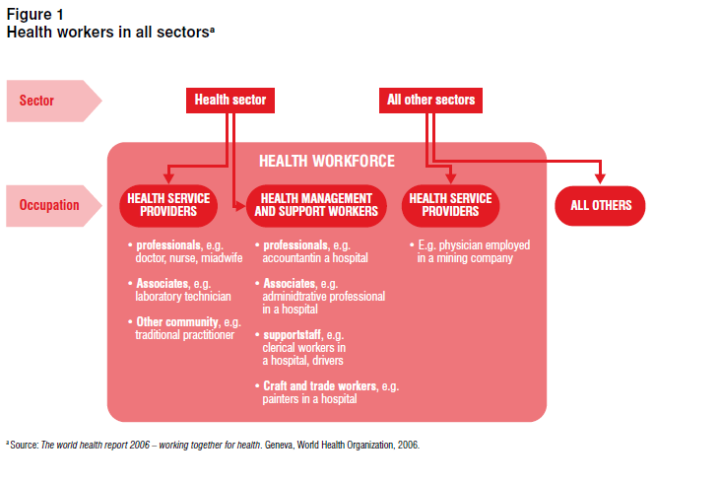

Slide 7
common HR concerns include:
Policy and planning issues
Recruitment;
Education and training;
Distribution and mix;
Enhancing productivity and performance;
Improving retention.

Slide 8
Human resources in Global Fund proposals
Involvement of health workforce stakeholders
In most proposals, some members of the CCM can be identified as stakeholders for human resources issues -mainly representatives of academic institutions, professional associations or the ministry of education.
The report of the Technical Review Panel on Round 5 proposals states: "The TRP is concerned that CCM composition has been built up based on the three diseases, so that many CCMs may lack the expertise to develop strong (health systems) proposals." They lack cross cutting experts..

Slide 9
Specific HR interventions in the proposals:
Training
Training is one of the main topics in proposals.
None of the reviewed proposals link their plans for capacity development to a coordinated country training plan.
Few interventions that support pre-service training institutions can be found in the proposals.
Updating curricula is a frequent activity but seems to be mainly an isolated exercise for the special Global Fund training programmes that are often limited to in-service training.

Slide 10
Specific HR interventions in the proposals: Recruitment
New/temporary posts are created for administrators, accountants, procurement and logistics experts or similar positions.
Staff are often hired only for the project time and may include external consultants, or secondments from the ministry of health.
Few of these positions have a long-term perspective - on the other hand, increased recruitment is planned for volunteer community health workers and volunteer staff for peer education.
So the programmes will not have a sustained HR base left after the project – partly the govt responsibility.
Therefore looks as if the number of core health workforce categories is rarely increased through Global Fund resources; countries are forced to look for more creative solutions to address human resources constraints.

Slide 11
Motivation and retention strategies
Motivation and retention strategies recognized as important issue but most proposals do not provide any strategies to address it …
Monetary incentives in addition to salaries are a controversial topic -and some remuneration strategies for volunteers who will not be paid a salary include travel and transport allowances, provision of motorbikes, and skills-building and training opportunities.
Performance based incentives and improved feedback and supervision systems are also suggested activities but not consistent.

Slide 12
Skill mix and regulation
Skill mix and regulation of human resources for health is strongly affected by Global Fund activities, especially through the creation of numerous new types of front-line health workers.
No overall skill mix plans.
Long-term effects on health service delivery as well the role of the professional associations in the CCM in this process pose interesting questions for future research.

Slide 13
Sustainability
Where the health workforce accounts for an important share of the budget - with regard to sustainability of salaries–few settled agreements for the time after the proposal period is over.
Vague statements may be found, such as "staffing costs will need to be absorbed into the MOH or other service delivery organization budgets" or "government should be able to absorb the additional staff"
Key weaknesses are a lack of a comprehensive situation analysis for the health workforce and a lack of overall health workforce development plans
Interventions for the strengthening of the health workforce mainly address single issues without providing a wider strategy for long-term success.
Numerous training activities are suggested, but they are not part of a coordinated country training plan.

Slide 14
Mid term review of 2015 (HIV Sri Lanka)
Recommendations
  Staff vacancies at STD clinics to be filled
  Provide incentives for working in geographically difficult areas
  Make training compulsory for all staff working in STD clinics
  Dialogue with Directorate of Education Training and Research of Ministry of Health
  about including HIV/AIDS in all curriculums

Slide 15
Malaria – HRH component
A few administrative positions supported
Technical –Ento, Epid, clinicians
Program support staff
  implementation –M&E, HR, Procurement
  Lab
  TB assistants
General staff

Slide 16
TB proposal
“The GF has transferred some good management practices which will be useful…..
Being a band 4 country we face some problems….GF not too keen to support staff, vehicles etc. but difficult for the govt also and hence not sure how we will sustain the recruits and how we will get the work done afterwards….
Therefore our HR transition plan is actually “hypothetical” and we are not sure if we will be able to absorb these additional temporary staff. Also we are not sure if we will have sufficient staff to sustain the services afterwards. However GF seems to be happy with our hypothetical plan.”

Slide 17
GF/SIIC10/paper 08:
Human Resources:
Human resource capacity building is sustained only when trainings are institutionalized in the national education system or within the Ministry of Health HR development programs.
Capacity building for the non health work force is likely to be abandoned after GF support.
Retention of grant supported professionals in the health system depends largely on the government’s staffing plans, availability of positions and on government’s commitment.
Most countries failed to sustain the HR capacity developed with GF support and to retain GF supported professionals in the pubic sector and/ or in disease programs.

Slide 18
conclusions
In countries like Sri Lanka the role of the government is very strong and donor funds, while being very important, is quantum wise not very large
CCM is not a nationally representative body in health policy formulation nor even a central player in the donor assistance
Therefore seems that the CCM is expected to bear an unreal role in terms of decision making
Issues of sustainability are rarely discussed as the CCM non govt sector has little role in this
Therefore inherent weaknesses prevail….

Slide 19
Conclusions
Reveal a struggle between the Global Fund's goal to fight the three targeted diseases, on the one hand, and the need to strengthen health systems as a prerequisite for success, on the other. Unfortunately, favour is to the Global Fund's disease-related objectives over cross-cutting issues.
In realizing the opportunities the Global Fund provides for human resources interventions, countries should go beyond short-term objectives and link their activities to a long-term development of their human resources for health.
One step that can be taken at the country level is to ensure more involvement of human resources stakeholders and experts in both the CCM and the proposal writing groups.
could play a more proactive role in formulating sustainable HR Plans during the transition

