Slide 1
Overview: Mandates , Architecture & Impact
The Global Fund
Dechen Wangmo
Date: 26th May 2016
Venue: Rochog Pel Hotel, Thimphu

Slide 2
Overview
Created in 2002: An innovative partnership between governments, private sector, NGOs, and international agencies. (Round 1 USD 600 Million for 36 countries)
Operate as a financial instrument, and NOT an implementing entity
Make available and leverage additional financial resources.

Slide 3
Vision and Purpose
“World free of the burden of HIV, TB and malaria”
“To dramatically increase resources to fight three of the world‘s most devastating diseases, and to direct those resources to areas of greatest need.”

Slide 4
Governance
Total 28 members
Non-voting Seats (8 seats)
20 Voting members (equal representation implementers and donors).
One seat each from Foundation, Private sector, CSO developed countries, SCO developing countries and communities (5seats)

Slide 5
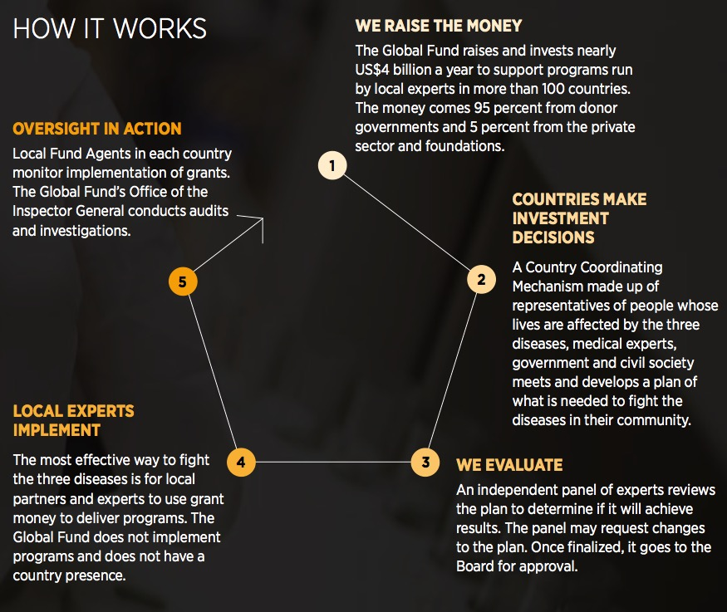
How it works?
1. United States US$ 10,149M 2. France US$ 4,123 M 3. United Kingdom US$ 3,225M 4. Germany US$ 2,374M 5. Japan US$ 2,156M 6. European Union US$ 1,641M 7. Canada US$ 1,377M 8. Italy US$ 1,049M 9. Sweden US$ 955M 10. The Netherlands US$ 919M
Donor governments (95%)
As of September 2015, the Global Fund disbursed US$27 billion

Slide 6
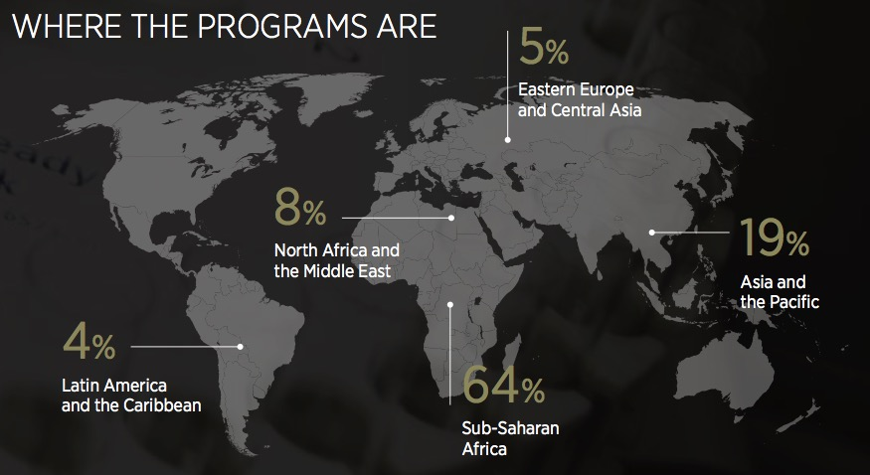
Coverage

Slide 7
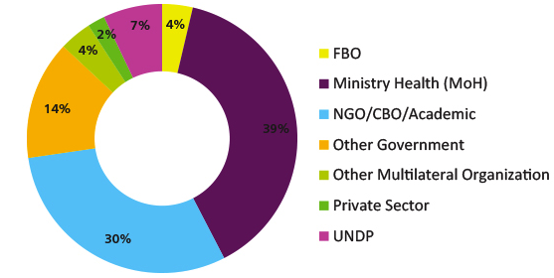
Grant Recipients

Slide 8
Operating Model
Raise it. The Global Fund continually raises funds to dramatically increase resources to fight three of the world's most devastating diseases.
Invest it
Prove it
Raise it
Invest it. The money received from donors is channeled to program implementers for grants operating in countries around the world.
Prove it. The achievements of grant activities are measured against performance indicators and the results are used for ongoing funding decisions.

Slide 9
General Principles
Support programs that reflect national ownership
Operate in a balanced manner in terms of regions, diseases, and interventions
Pursue an integrated and balanced approach to prevention and treatment
Evaluate proposals through independent review processes
Promote a simplified, rapid, and innovative grant-making process.
Operate transparently, with accountability
Notes:
6 GP

Slide 10
General Principles
No performance
No report
NO Money

Slide 11
WHY Performance Base Funding?
Link funding to the achievement of country-owned objectives and targets
Focus on programmatic results and timely implementation
Encourage learning to strengthen capacities and improve program implementation
Invest in the use of evidence for decision-making
Provide a tool for grant oversight and monitoring within countries and by the Global Fund Secretariat
Free up committed resources from non-performing grants for re-allocation

Slide 12
Process of PBF
Grant recipients report regularly on results & expenditures (semi-annually)
Local Fund Agents (LFAs) verify reported results & expenditures
Performance evaluated and rated at every progress update
Performance influences disbursement & future funding decisions

Slide 13
Key Results: Global
Notes:
Till date 11.07 Million and disbursed 10.18 million : early round 4 TB (2005)

Slide 14
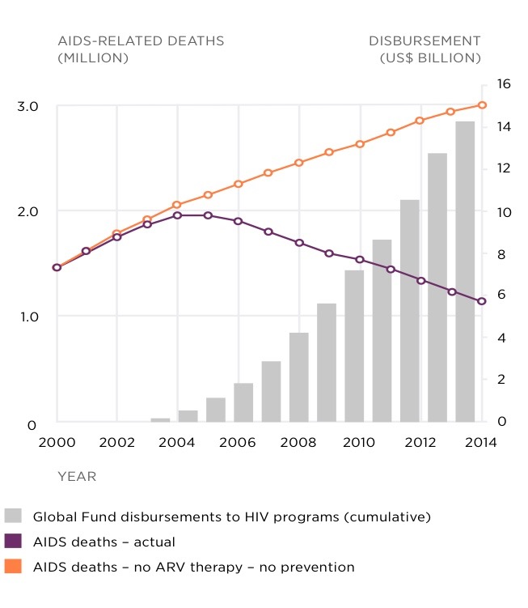
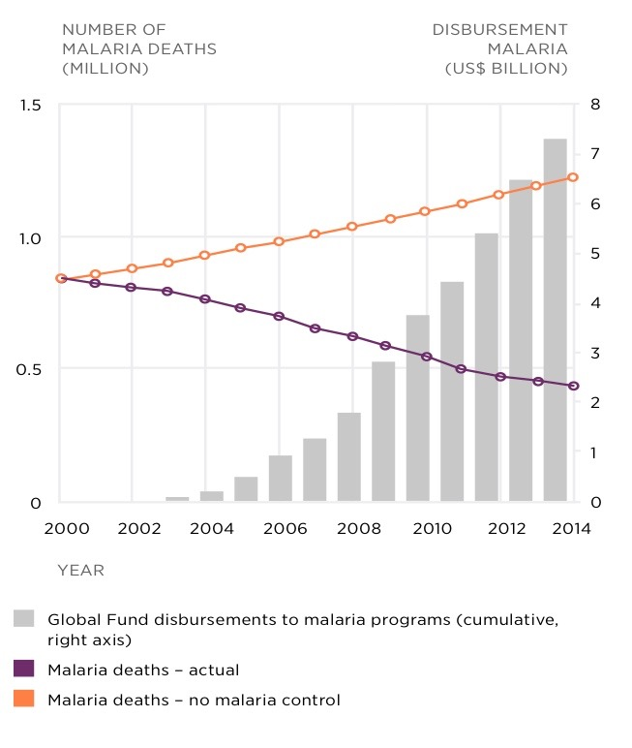
Impact HIV/TB/ Malaria

Slide 15
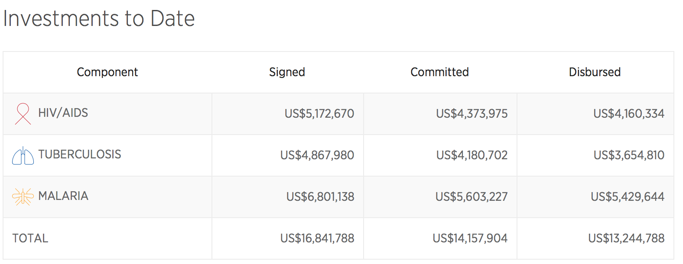
Key Results: Bhutan
HIV | TB | Malaria
160 | 4,200 | 362,000
HIV/AIDS: People currently on antiretroviral therapy | Tuberculosis: New smear-positive TB cases detected and treated | Malaria: Insecticide-treated nets distributed

Slide 16
Global Fund institutions at country level
CCMs, PRs, SRs, LFAs

Slide 17

Architecture
LFA
CCM
PR
SR
The Nation
SR
SR
SR

Slide 18
What is a CCM?
Country Coordinating Mechanism(CCM)
CCMs are partnerships consisting of representatives from both the public and civil society sectors who coordinate the submission of one national proposal on the basis of priority needs.

Slide 19
Representation
Government (Public Sector)
Education/Universities
National and Community Based NGOs
Association of people living with AIDS/TB/Malaria
Key effected people
Private Sector
Faith-based organization
Bilateral/Multilateral development Partners
Minimum 40%
membership
Ensure Gender Equity and Geographic representation

Slide 20
CCM Composition
Members represent their constituency, not themselves nor their institution.
The CCM governs in the national interest.
The CCM neither manages nor executes Global Fund grants.

Slide 21
Key Functions of CCM
1
Organization & functioning of the CCM & Secretariat
2
Harmonization of GF funds with other resources
3
Documentation & communication with constituencies & GF
4
5
Proposal development
Oversight of grants & Principal Recipients

Slide 22
Bhutan CCM Structure
Full CCM
CCM =
CCM Executive Committee
Oversight
Committee
(NO PR/SR)
Proposal
Development Committee
TWG
AIDS
TWG
TB
TWG
M
CCM Secretariat
Notes:
Proposed and endorsed in july 2010

Slide 23
Roles & Responsibilities: CCM
Identify National priorities and gaps in programmatic, technical, geographic coverage and financial support
Promote multi-sectoral participation
Ensure the harmonization of GF grants with other support for the three diseases
Coordinate and ratify grant proposals
Selection of Principal Recipients
Ensure grant oversight
Ensure transparency with stakeholders and the Global Fund

Slide 24
Roles & Responsibilities: Member
Respect and comply with the Governance Manual
Participates in all CCM activities
Share experiences & information
Respect and comply with CCM decisions
Share information and decisions back to member’s constituency
Represent views of constituency - not of an organization or personal views
Declare potential Conflict of Interest when CCM discuss issues related to the Members

Slide 25
Executive Committee: TOR
The CCM Executive Committee is responsible for:
  Coordinating and directing the activity of CCM Secretariat
  Supporting and coordinating ad-hoc working groups,
  Attending to routine or urgent communications for which calling CCM meetings is not feasible.
  Decision-making authority limited to administrative matters may be delegated by the CCM to the Executive Committee.
All major decisions (both Financial and Programmatic) should be taken by the FULL CCM

Slide 26
Executive Committee
Membership (4)
Comprise the CCM Chair, the CCM Vice-Chair, the Chair Oversight Committee and the Chair of the Proposal Development Committee.

Slide 27
Oversight Committee : TOR
Members will ensure oversight in relation to the following functional areas:
    Finance;
    Procurement;
    Implementation;
    Results and Reporting
    Technical assistance.
    Development of OSP to identify potential implementation bottlenecks
    enhance transparency with regards to grant implementation

Slide 28
Oversight Committee
Membership (6)
The Oversight Committee shall consist of a Chair, a Vice-Chair, and 4 Ordinary Members.
Membership of the CCM is not a prerequisite for membership for Oversight Committee (exception: Chair and Vice-Chair)
Should NOT be representatives of PR nor SR nor SSR institutions.
Skill set: Finance, Procurement and Management expertise.

Slide 29
Proposal Development Committee: TOR
Coordinates the preparation of proposals by the CCM;
Liaising with national agencies and development partners to ensure harmonization of GF programs with other programs.
Ensure robust gap analysis for proposal development in line with the national strategy.
Assists CCM in fulfilling its responsibility to ‘coordinate the submission of one national proposal for funding.
Prioritize needs, and identify the comparative advantages of each proposed partner.

Slide 30
Proposal Development Committee
Membership (5)
Chair, and Vice-Chair, and up to three Ordinary members who need not be CCM members.
Members must belong to different sectors.
Committee shall not include members whose organization is proposing to be a PR or SR in a current GF round.
All committee members, shall comply with the CCM COI Policy.
Access technical advice from development partners and other sources of expertise, including prospective PRs, SRs or SSRs

Slide 31
PR and SR
The Principal Recipient is the institution with whom the grant agreement is signed and is the one legally responsible for the execution of the contract with the Global Fund.

Slide 32
Process
Selection of PR
Assessed by the LFA
Confirmed (or rejected) by the Global Fund
PR sign the grant
agreement
with the GF
Becoming a Principal Recipient
CCM

Slide 33
PR Functions
Grant Implementation
Technical Coordination
Financial Management
Monitoring & Reporting
Procurement Management and monitoring
Partnership coordination and SR management

Slide 34
CCM & PR key boundaries
CCM
PR
Proposal Development and PR selection
Grant oversight and resolution of systemic problems and bottlenecks
Evaluate PR for next phase of funding
PR signs agreement with the Global Fund
PR is responsible for grant implementation, monitoring and reporting
Responsible for financial management, procurement and technical & partnership coordination

Slide 35
Implementers
Informal Networks
PR
SR
SSR
SSR
SR
SSR
Lhaksam
DOPH

Slide 36
Local Fund Agent (LFA)
The LFA is an essential component of the GF architecture and is contracted and paid directly by the GF
The LFA functions as the “eyes and ears” of the Global Fund in each country.
The LFA does not act as the GF representative and cannot speak for the GF
The LFA provides independent, objective and professional opinions and support the Global Fund concerning the grant mangagement and performance

Slide 37
Comments and Quotations

Slide 38
Conflict of Interest
What when and how?

Slide 39
What?
A conflict of interest occurs when a member of the CCM or the CCM Secretariat uses his or her position to advance his/her personal ambitions or interests, the interests of his/her institution or those of his/her family, or close associates in a way that disadvantages or excludes others.
Recommended that COI policies apply to all members of the CCM

Slide 40
Guiding Principles for COI
CCM activities should promote transparency and accountability in order not to undermine the integrity and legitimacy of the CCM
COI should be managed through formal policies and procedures

Slide 41
Potential Area of COI
Selection of PRs and SRs
Renewal requests for a forthcoming phase of a grant
Substantial reprogramming
Issues relating to assessment, monitoring, and oversight of PRs and SRs
Discussions of matters for which CCM members or their institutions have a financial interest, such as contracting, recruitment of staff, etc.

Slide 42
Eligibility Requirements
To avoid conflict of interest (Art 21):
Chair and Vice Chair to be from different entities
CCM must have a written plan to mitigate conflict of interest (COI) if Chair or Vice Chair (s) and PRs are the same entity
Chair and Vice Chair, if PRs, should not participate to discussions and decisions related to PR selection, PR renewal for Phase 2, reprogramming of funds, or anything that has a financial impact on the PR (i.e., contract with SRs, staff recruitment, procurement, etc)

Slide 43
Thank you!
Comments and Questions!

