Slide 1
Malaria Elimination in South East Asia Region Progress, Challenges and the Way Forward
Dr. Deyer Gopinath, WHO / Thailand
Dr. Leonard Ortega, WHO / SEARO

Slide 2
Contents
Malaria situation: global and regional
Malaria goals and targets: post 2015
Strategies
Key challenges
Opportunities
The way forward

Slide 3
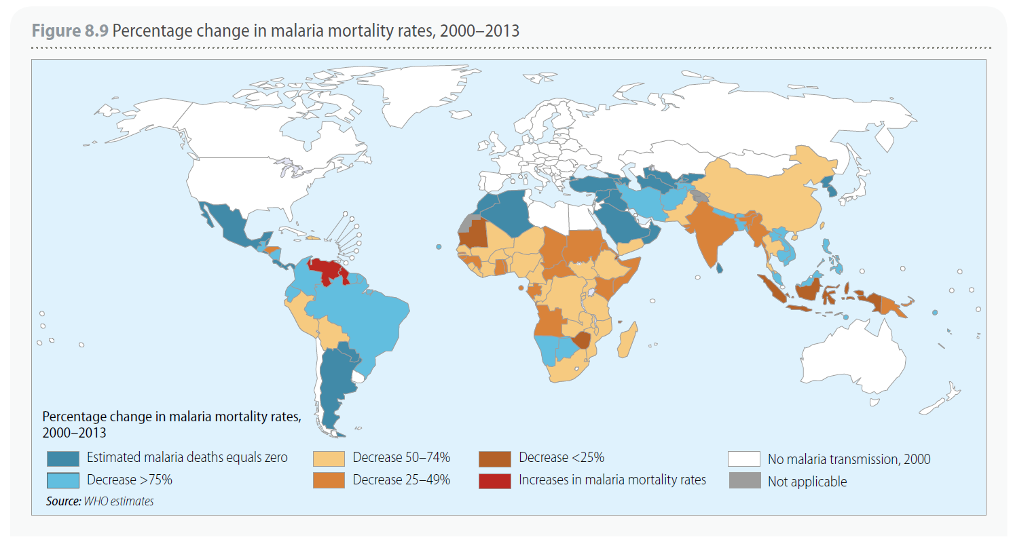
Global Malaria Situation (1) Change in malaria mortality rate 2000-2013
estimated malaria deaths: 584 000 deaths (uncertainty range: 367 000–755 000)
90% of all malaria deaths occurred in WHO African Region, mainly in children aged under 5 years, who account for 78% of all malaria deaths
globally between 2000 and 2013: 4.3 million deaths averted
[Reference: World Malaria Report 2014]
Notes:
estimated malaria deaths: 584 000 deaths (uncertainty range: 367 000–755 000)
90% of all malaria deaths occurred in WHO African Region, mainly in children aged under 5 years, who account for 78% of all malaria deaths
globally between 2000 and 2013: 4.3 million deaths averted
Reference: World Malaria Report 2014

Slide 4
Global Malaria Situation (2) Trends in reported cases of malaria
64 out of 106 countries with malaria in 2000 are meeting the MDG target of reversing the incidence of malaria
55 are on track to meet RBM and WHA targets of reducing incidence rates by 75% by 2015
Estimated cases in 2013: 198 million cases

Slide 5
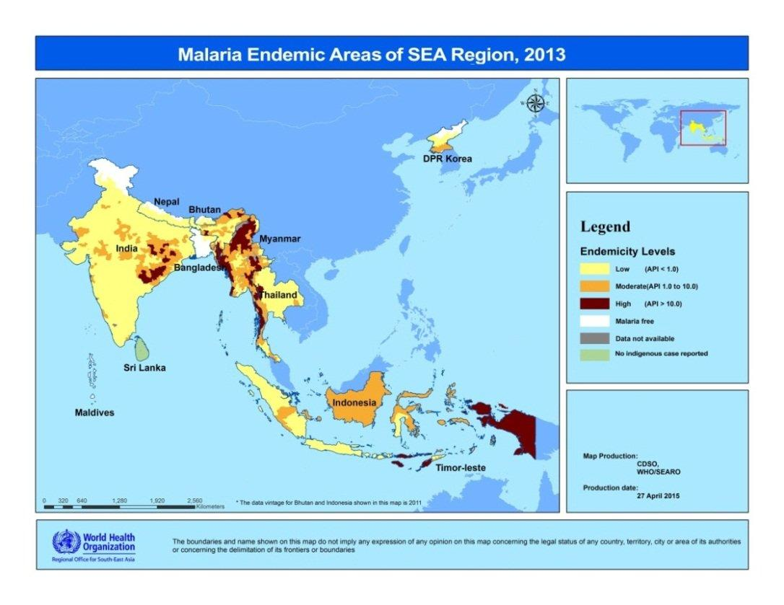
Regional Malaria Situation
Ten of 11 Member States in WHO South East Asia Region are endemic to malaria.
Around 1.1 billion population at risk of malaria.
High risk groups are mainly the mobile and migrant populations engaged in various economic activities in rural areas in the region, in hard to reach areas , tribal communities and along the borders where access to health services is a challenge.
Notes:
Ten of 11 Member States in WHO South East Asia Region are endemic to malaria.
Maldives is free of malaria transmission since 1984. WHO Certification acknowledging malaria free status of Maldives is expected to be issued before the end of 2015.
Around 1.1 billion population at risk of malaria. High risk groups are mainly the mobile and migrant populations engage in various economic activities in rural areas in the region as well as in some peri-urban areas in India.
Significant progress was noted since 2000. High risk areas are limited mainly in hard to reach areas in India where majority are tribal communities such in India and eastern Indonesia, in development project sites in rural areas and along the borders where access to health services is a challenge.

Slide 6
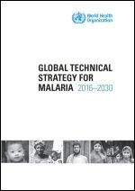
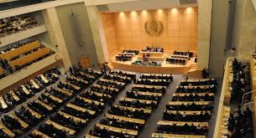
Global Technical Strategy for Malaria
Endorsed by WHA in May 2015, joint GTS/AIM launch at 3rd Intl Conference on Financing for Development - Addis Ababa, July 2015
Global goal for 2030: A world free of malaria
Reduce malaria mortality rates globally by at least 90% compared with 2015 Reduce malaria case incidence globally by at least 90% compared with 2015 Eliminate malaria from at least 35 countries in which malaria was transmitted in 2015 Prevent re-establishment of malaria in all countries that are malaria-free
Notes:
The global community, specifically the World Health Assembly, endorsed the Malaria Global Technical Strategy. Adaptation of the strategy at regional and country levels are on going.

Slide 7
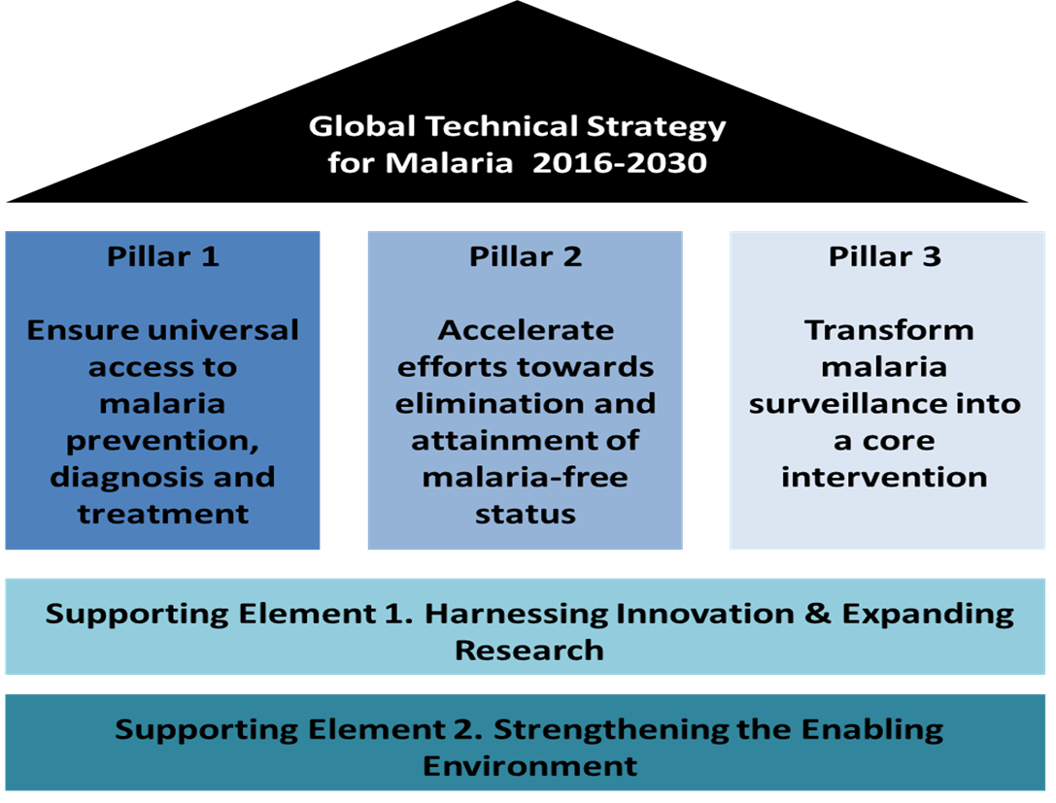
Regional Strategic Objectives vs. Global Technical Strategy
Regional Strategic Objectives 2014 - 2020
Generate strategic information
Scale-up key interventions in countries and areas with high burden of malaria
Reorient national malaria control programmes towards pre-elimination/elimination in countries with very low burden of malaria
Prevent the emergence of artemisinin resistance, and eliminate it in areas where it has already emerged
Strengthen managerial and technical capacities
Strengthen partnerships, multi-sectoral participation and international collaboration
Notes:
The WHO Regional Office is in the process of aligning the regional strategy to the Global Technical Strategy.
The strategy will include game changing approaches or innovations to support countries accelerate progress towards malaria elimination and prevent re-introduction.
In the Greater Mekong Sub-region, the Strategy for Malaria Elimination was developed and launched in May 2015 at a side event during the World Health Assembly. The goal of the strategy is to eliminate malaria in the Greater Mekong Sub-region and get rid of drug resistance in that part of the world.

Slide 8
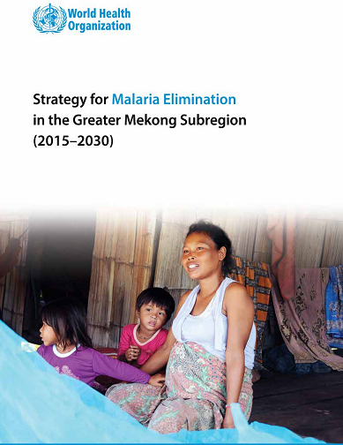
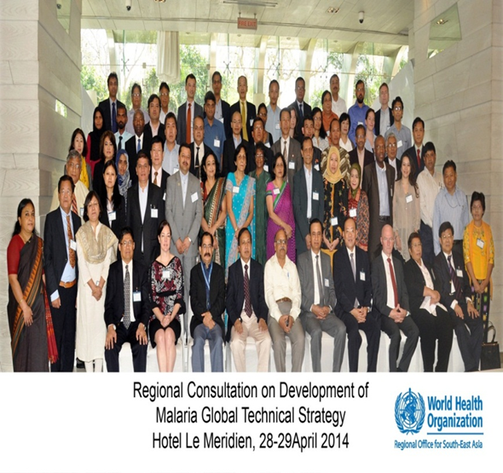
Regional Plans in development
GMS strategy – May 2015 launch
AFRO – Sep 2015 consultation
SEARO – Oct 2015 draft
PAHO – Oct 2015 consultation
EMRO – Oct 2015 regional committee
WPRO – Dec 2015 consultation
EURO – Sep 2016

Slide 9
Regional Malaria Situation (1) Success story in India
Annual Parasite Incidence, 2000
Annual Parasite Incidence, 2014
Around 55% of the total malaria incidence in the South East Asia Region.
In the last 10 years: reported malaria cases declined by 42% from 1.9 million to 1.1 million in 2014, and malaria related deaths was reduced by 41% from 949 in 2004 to 562 in 2014.
The number of districts with API less than or equal to one has increased from 370 in 2000 to 527 in 2014 (total districts currently: 620)
Notes:
India accounts for around 55% of the total malaria incidence in the South East Asia Region.
In the last 10 years: reported malaria cases declined by 42% from 1.9 million to 1.1 million in 2014, and malaria related deaths was reduced by 41% from 949 in 2004 to 562 in 2014.
In 2014, most cases reported are from Odisha (36%), Chattisgarh (12%), Jharkhand (9%), Madhya Pradesh (9%), Maharashtra (5%) and Tripura (5%)
The number of districts with API less than or equal to one has increased from 370 in 2000 to 527 in 2014 (total districts currently: 620)

Slide 10
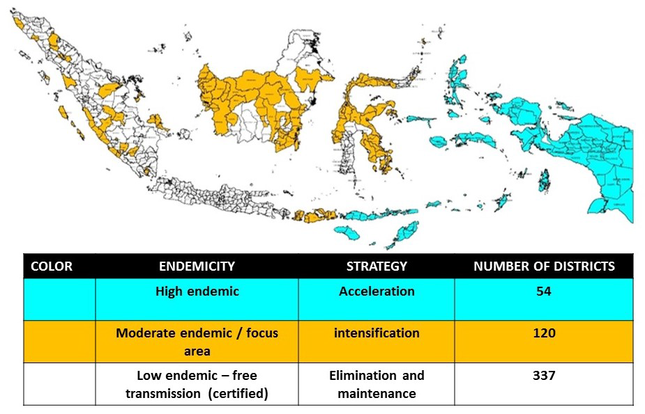
Malaria Elimination in Indonesia
Indonesia: 152 million at risk, 252,027 cases confirmed in 2014; down from 417,819 in 2012; sub-national malaria elimination progressing well (225 out of 511 districts declared malaria free)
Notes:
As well, Indonesia is accelerating sub-national malaria elimination with the goal of eliminating malaria by 2030.

Slide 11
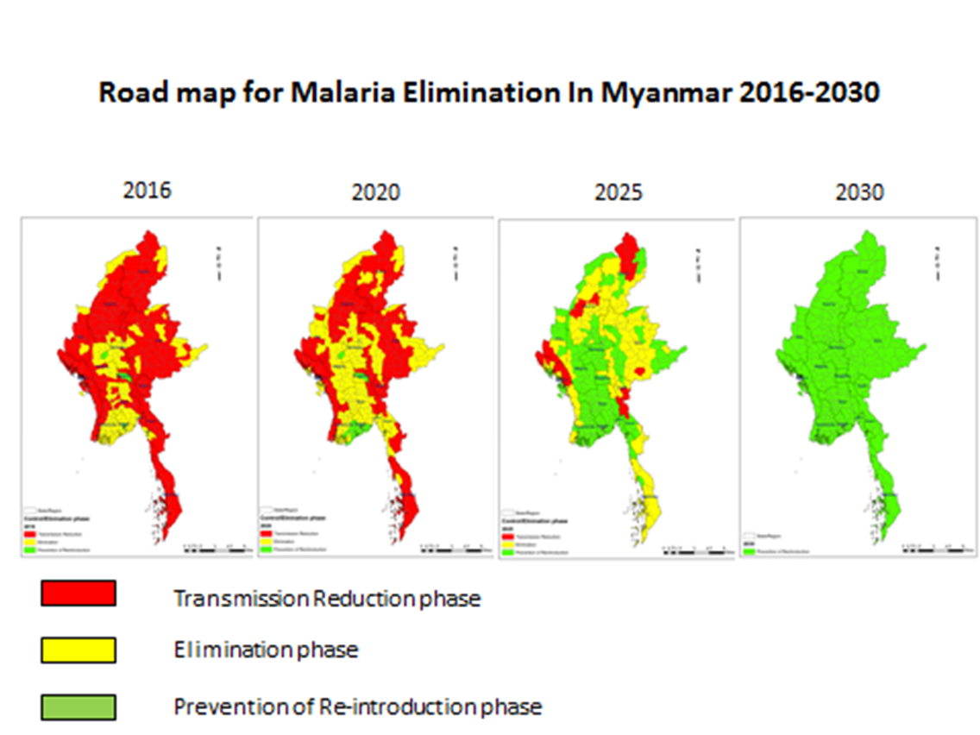
Myanmar: 67% reduction of cases (622,373 in 2005; 205,658 in 2014); 95% reduction of deaths (1,707 in 2005; 92 in 2014)
70-80% burden in GMS, 32 million population at risk, 300,000+ cases in 2013
Notes:
Countries in the region are in the process of adapting the Malaria Global Technical Strategy to accelerate progress towards malaria elimination.
Myanmar is an example wherein the national strategic plan is being updated to align with the Strategy for Malaria Elimination in the Greater Mekong Sub-region and in line with GTS.

Slide 12
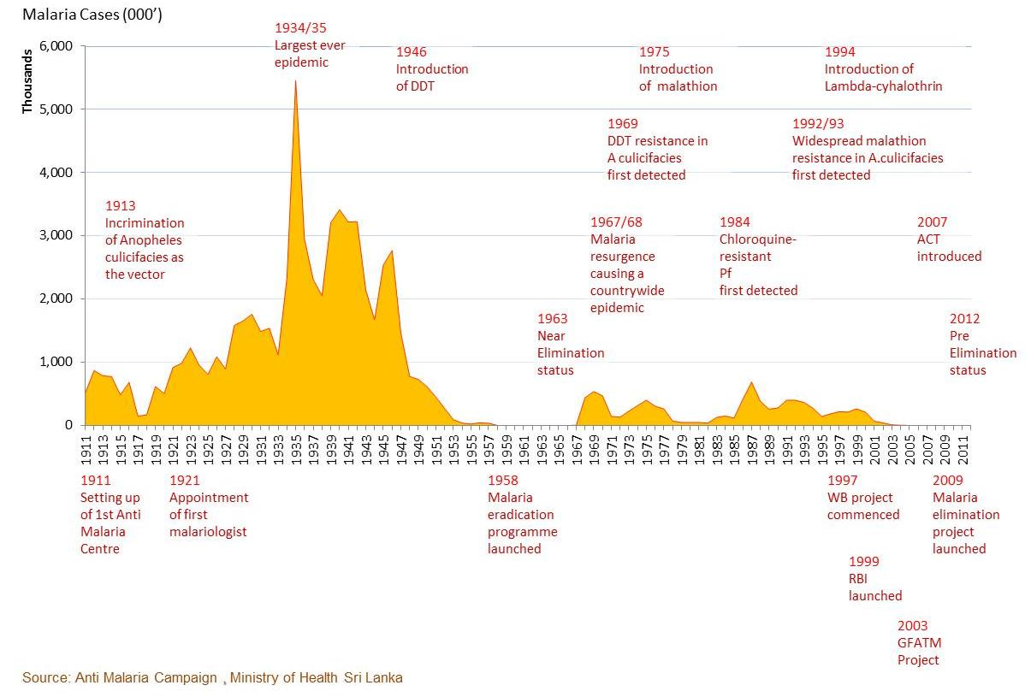
Malaria incidence in Sri Lanka, 1911-2015 (Oct 2015)
Sri Lanka: reduced cases from 210,000 in 2000 to zero 2013
Notes:
Member States, with support from WHO and other development partners, made significant progress in the past as exemplified by Sri Lanka where malaria was nearly eradicated in 1960s. But for various reasons, malaria came back with vengeance in many countries.
In recent years, with support from the Global Fund, WHO and other key partners, we are again about to eliminate malaria in several countries including Sri Lanka.
In November 2014. during the East Asia Summit, the Heads of Government of various countries committed to eliminate malaria in Asia Pacific by 2030. With this political commitment, the time has come to accelerate progress towards malaria elimination and prevent re-introduction of transmission.

Slide 13
Regional Malaria Situation Success stories
Maldives: first country to elimination malaria (last indigenous case: 1984)
Bhutan: reduces cases from more than 5000 in 2000 to only 11 indigenous cases in 2014
DPR Korea: reduced cases by 91% from 115,615 in 2001 to only 10,535 in 2014; no malaria death
Timor Leste: cases decreased from 223,002 in 2006 to 1,040 cases in 2013
Thailand: cases decreased from 64,957 in 2010 to 37,680 in 2014 with deaths reduced from 80 to 37.

Slide 14
Malaria Elimination in SEARO
Country | Target year for elimination and remarks
1. Bangladesh | 2020; not feasible; Malaria National Strategic Plan (NSP) will be revised
2. Bhutan | 2018; feasible; cross-border collaboration with India being strengthened; 11 indigenous case in 2014
3. DPRK | 2025; 10,535 cases reported in 2014; intensive operations needed to reach elimination goal by 2020
4. India | 527 districts with API less then 1/1,000; pre-elimination phase in the whole country by 2017; elimination by 2030; elimination plan to be launched in Feb 2016
5. Indonesia | 2030; subnational elimination on track; 225 districts already declared malaria free
6. Myanmar | 2030; significant progress; NSP being updated
7. Nepal | 2026; feasible; it could be achieved earlier than 2026
8. Sri Lanka | zero indigenous case since Oct 2012; certification being planned in 2016
9. Timor Leste | elimination goal agreed but target year not yet decided; marked reduction of cases from 223,002 in 2006 to 1,040 in 2013
10. Thailand | 2024; feasible; program review done recently; NSP being updated

Slide 15
Key Challenges
Drug resistance
The long-term usefulness of ACTs is threatened by the emergence or spread of resistance to artemisinin
Insecticide resistance
Pyrethroids are key to vector control but resistance is widespread
Infectious reservoir
Millions of people with undetected malaria infection represent a large reservoir of parasites that can fuel transmission
P. vivax
P. vivax poses numerous unique diagnostic and therapeutic challenges that disproportionately affect vulnerable groups
Outdoor biting vectors
These mosquitoes are not targeted by core vector control methods and pose a challenge for prevention of transmission
Unregulated private sector
Many people seek treatment in the private sector where there is poor regulation of diagnostic and therapeutic practices
Health system
Shortages of human and material resources and poor infra-structure adversely affect case management, vector control & surveillance
Financial resources
The greatest threat to continued success in malaria efforts is financial
Notes:
While successes are notable, challenges also abound. We need to collective address the following challenges:

Slide 16
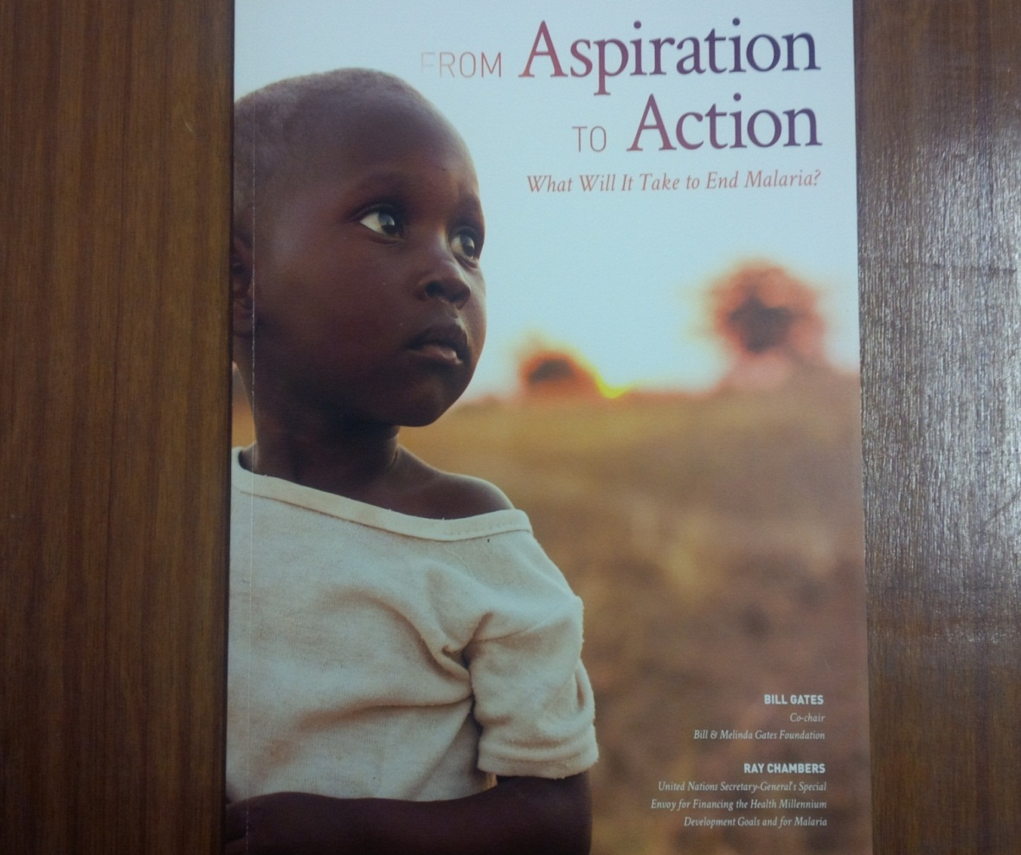
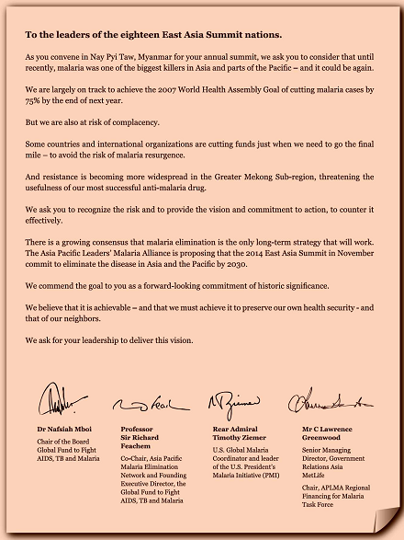
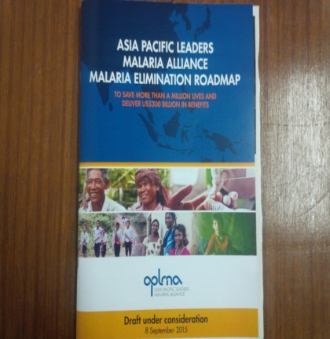
Opportunities (1): strong political support and global interest
Notes:
The call for malaria elimination has galvanized political leaderships and many development partners to support malaria endemic countries and to invest in research and development.
We need to show impact to sustain strong political support and financial commitments.

Slide 17
Opportunities (2): tools and innovations
Diagnostics
Rapid diagnostic test for malaria
Rapid diagnostic test for GPD deficiency
PCR (for field use)
Drugs
On going research on new molecules
Tafenoquine (for radical cure; single dose)
Vaccine
Research on prevention of outdoor transmission
Mass drug administration
Information technology for surveillance
Tool kit for malaria control among mobile and migrant populations
Community-based interventions
Plasmodium vivax control and elimination: a technical brief

Slide 18
The way forward (2)
Innovative and sustainable financing
Efficient and effective utilization of resources
Invest in health system strengthening
Multisectoral engagement
Cross-border / inter-country collaboration
Notes:
As mentioned earlier, sustainability of financial support is a major threat to malaria elimination.
The is a need for innovative and sustainable financing. And equally important is to find ways to efficient and effective utilization of resources.
We need to invest in health system strengthening, in particular in areas that would strengthen health human resources needed for malaria elimination, improve surveillance and response, and improve delivery of services to all populations at risk of malaria,
We should capitalize on the political commitments to improve cross-border / inter-country collaboration.

