Slide 1


Bhutan CCM :
(Election Process, Nomination of Sub Committees, Update)
Country Coordinating Mechanism (CCM) Secretariat
The Global Fund to fight HIV/AIDs, Tuberculosis and Malaria
P.O.Box# 726, Ministry of Health Building
Thimphu: Bhutan
Tel/Fax: +975- 2 331751
URL: bhutan.org

Slide 2
Election of CCM Vice Chair
As per the Governance Manual, the CCM shall elect one Vice-chair (either from civil society or from multi/bi-lateral sector, this is to ensure balance.
All CCM Members will vote by means of secret ballot for only one candidate.
Quorum for election of CCM Vice-Chair shall be two-thirds of appointed members.
Alternates shall not participate in election of the CCM Vice-Chairs.

Slide 3
Election Process
Steps for voting :
Election Committee of three shall be constituted.
All ballot papers shall consists of signature of the Secretariat and a serial number.
Ballot papers shall be placed in a ballot box.
The election committee will open the ballot paper and read out each name on ballot paper and count the votes.
The committee will declare results of the election.
If there are two candidates with equal number of votes, all the members shall vote for the second round to the two candidates.

Slide 4
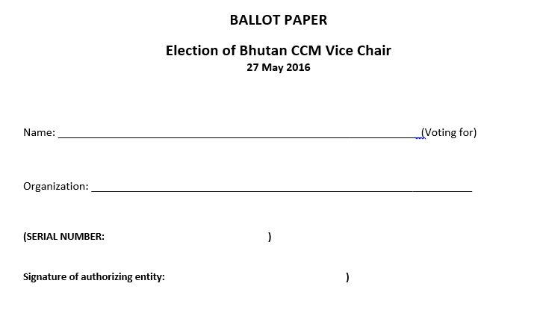
Ballot paper

Slide 5
Selection of CCM Oversight
CCM shall select members to the positions Oversight committee.
Individuals who are employed by a principal recipient, a sub-recipient, a sub-sub-recipient, or who otherwise have a conflict of interest within the terms of the CCM Conflict of Interest Policy are ineligible for membership
The functions of the Oversight Committee shall be determined by the Terms of Reference of the CCM Oversight
The Oversight Committee shall have 6 members in total of CCM and non CCM members.
All members are required to sign COI,
Expertise : Technical, Financial, Management, procurement expertise.

Slide 6
Proposal Development Committee.
Consist of 6 members in total, 3 CCM members and 3 Ordinary.
All CCM members appointed to the Committee must belong to different sectors.
The Proposal Development Committee shall not include members whose organization is proposing to be a PR or SR in a current Global Fund round.
All Committee members, both CCM and Ordinary, shall comply with the CCM Conflict of Interest Policy.
Members may be appointed to the Proposal Development Committee on an annual basis and may be reappointed for further terms.
The Proposal Development Committee may access technical advice in the relevant disease and service development areas from development partners and other sources of expertise, including from persons inorganizations proposing to be PRs, SRs or SSRs in current rounds, however, those persons will not be members of the committee.

Slide 7
Update
CCM Secretariat staff recruitment :
Under CCM funding budget two staffs
Advertised in the media three times with the criteria :
Title : CCM Coordinator
Position level: P3-A
Required qualification: 5-8 years work experience plus qualification of Bachelors degree, preferably Masters Degree in Public Health / Financial Management/ Business Administration/ Commerce or with work experience in related field.
1st call – three applicants, one withdrew and another was out of country.
2nd call- two applicants, one withdrew.
3rd call- no applicants.

Slide 8
Endorsement.
Endorsement on CCM coordinator’s effective date of release order as CCM Coordinator.
(Left office 1st wk June 2015 on leave, an office later received his resignation on 8 August). No release could be issued as there were no audit clearance. Now clearance is received. Secretariat used the expertise of MOH-HR, they recommended to issue release order w.e.f 30 June).

Slide 9
Information
GF mission in Bhutan from 6-9 June.
Transition meeting on 8-9 June at Terma Linca
Debrief session on 9 June for CCM and with programs at Terma Linca at 2:00 pm (2 hours).

Slide 10
THANK YOU

